Slide 1
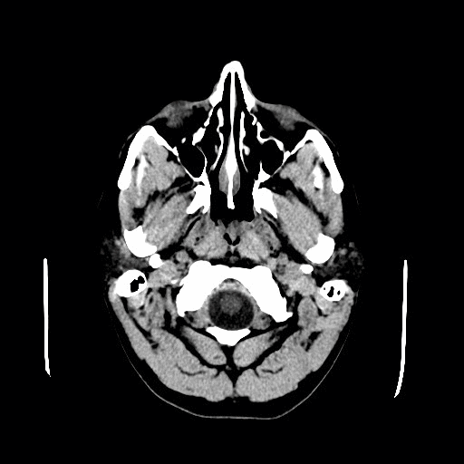
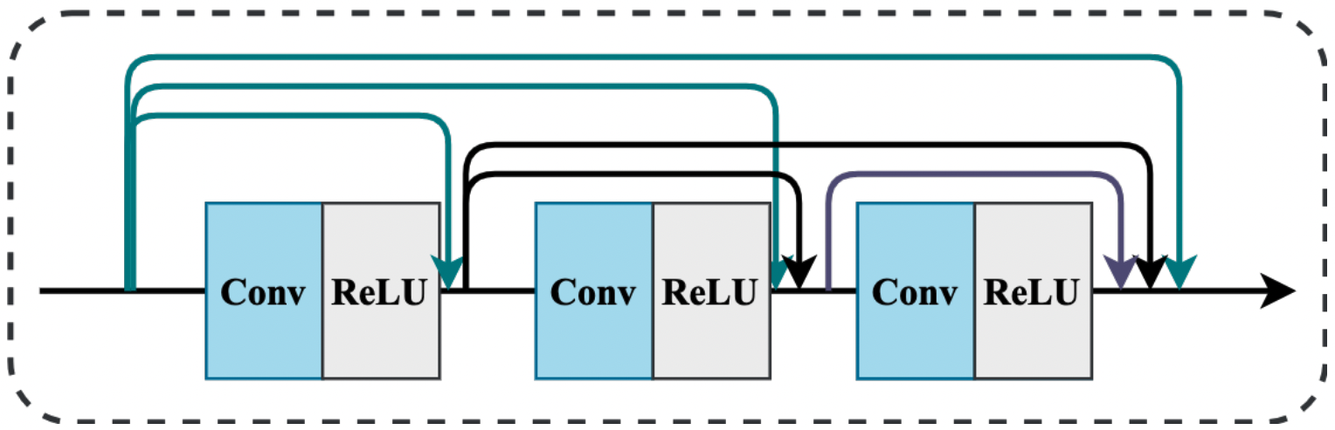
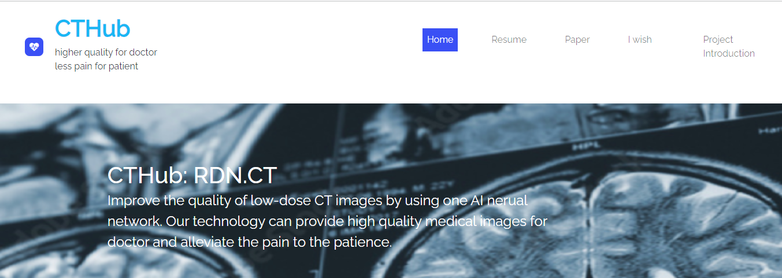
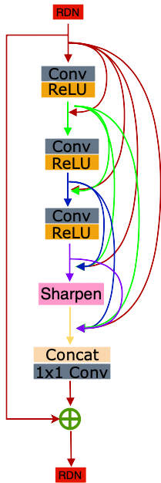
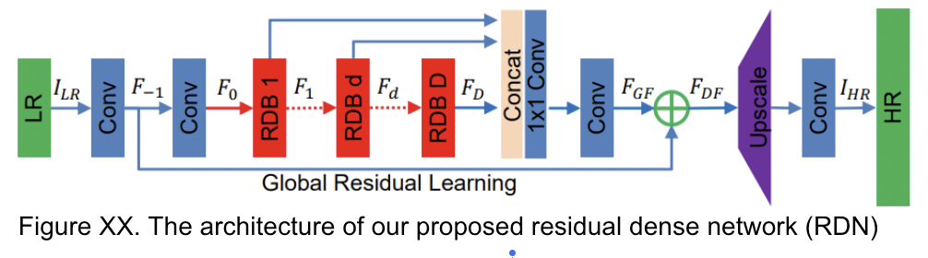
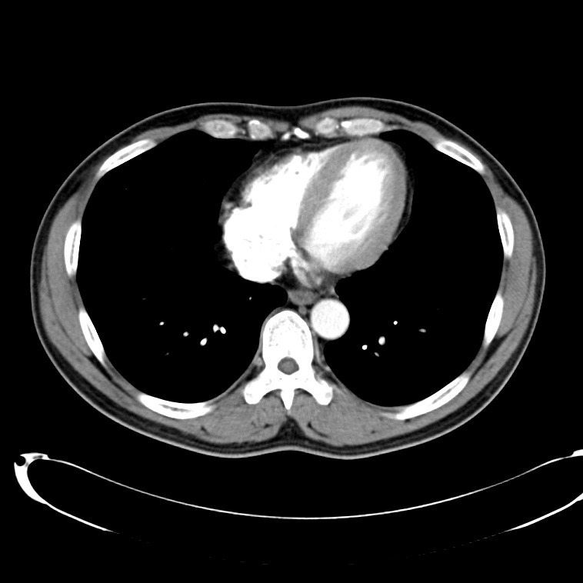
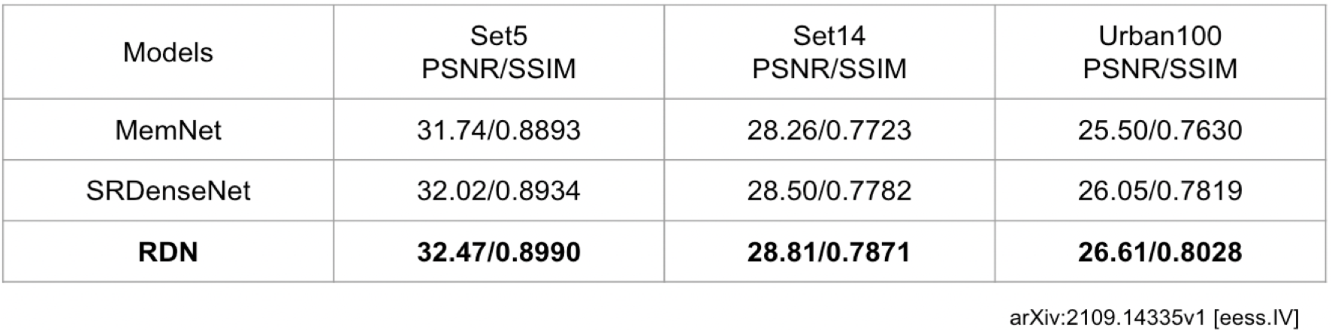
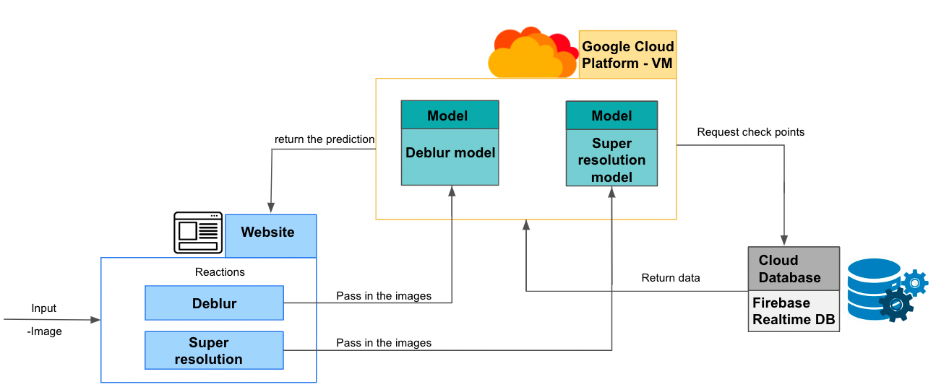
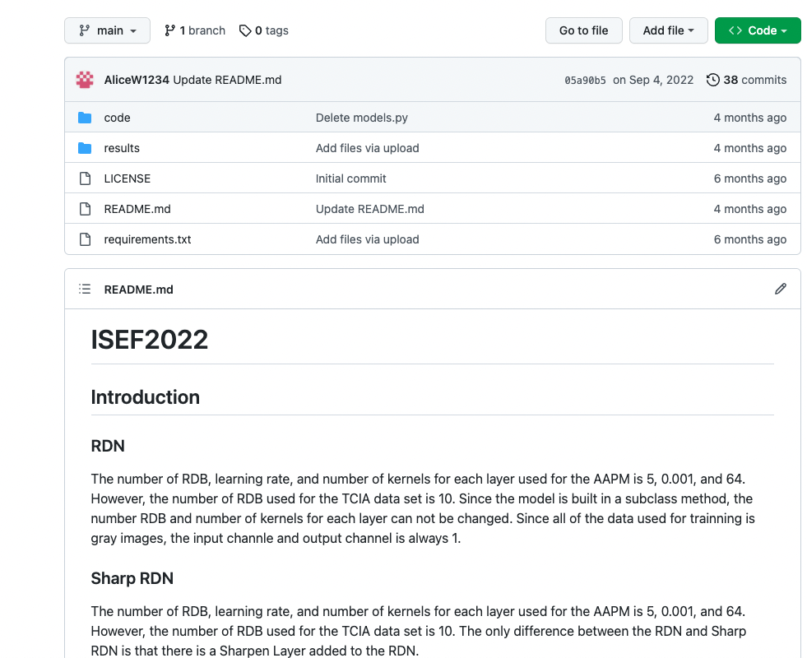
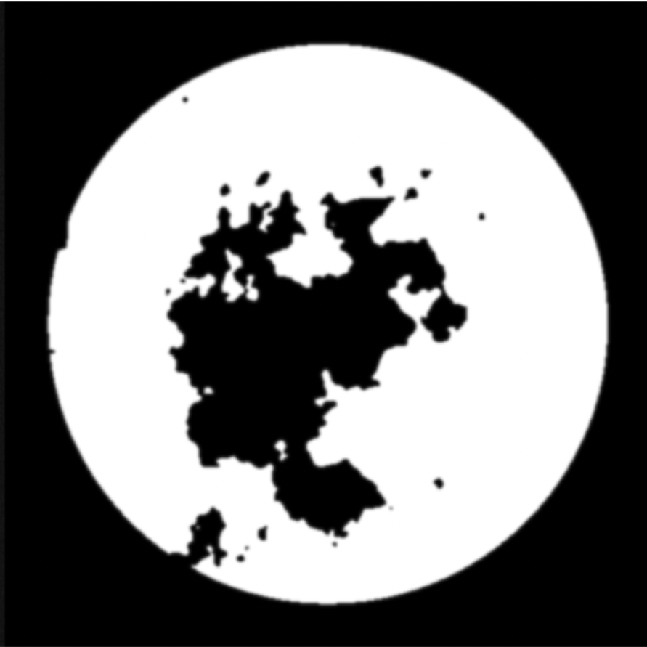
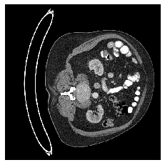
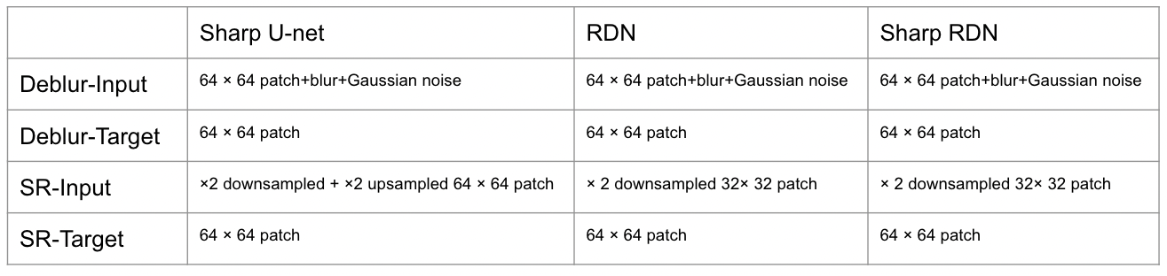
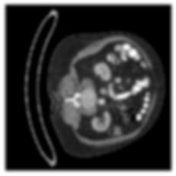
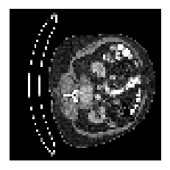
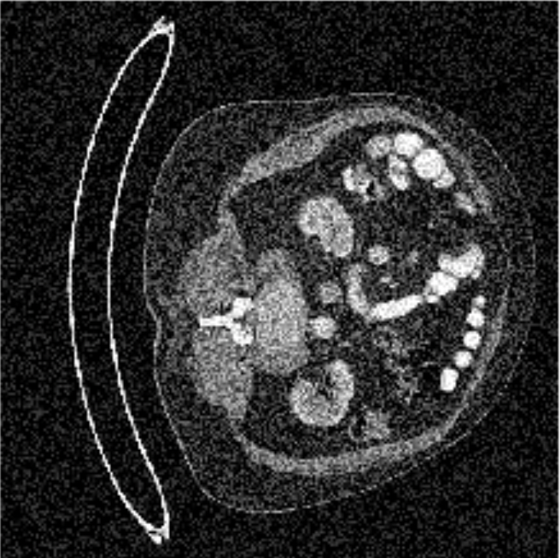
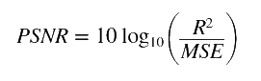
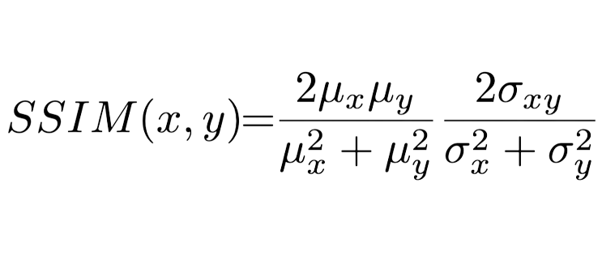
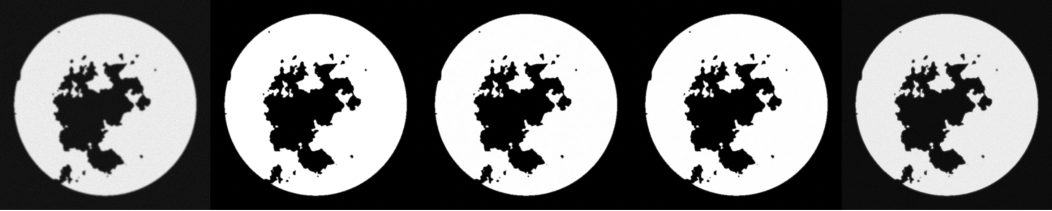
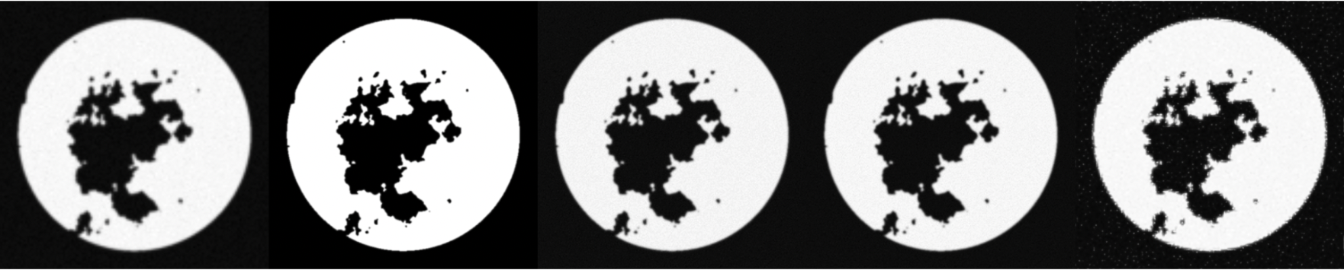
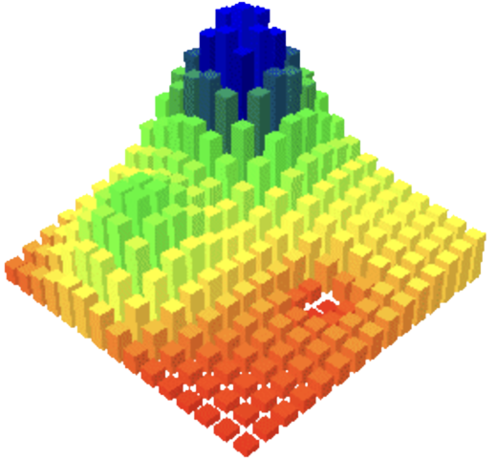
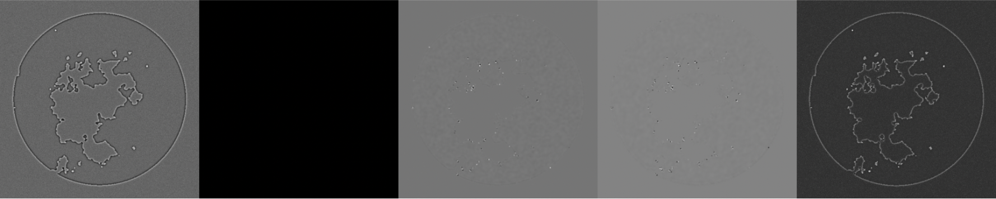
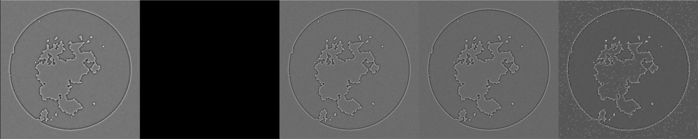
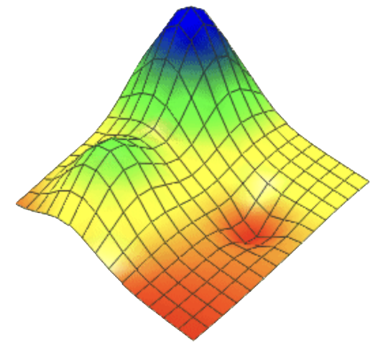
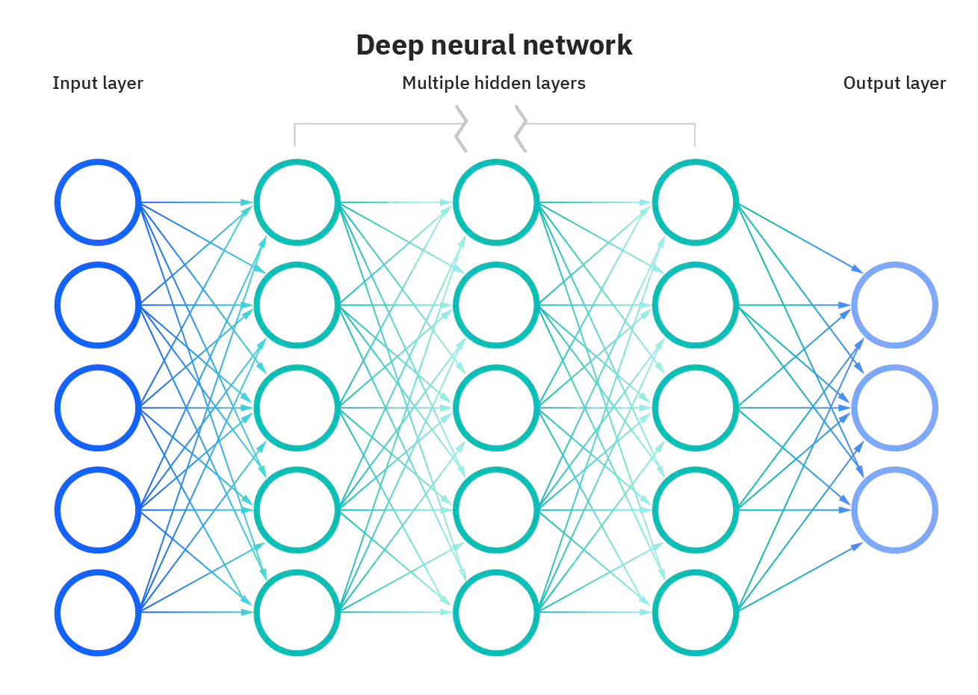
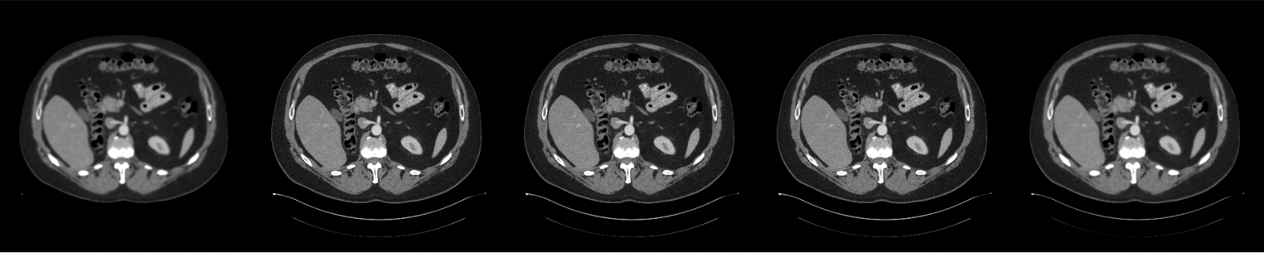
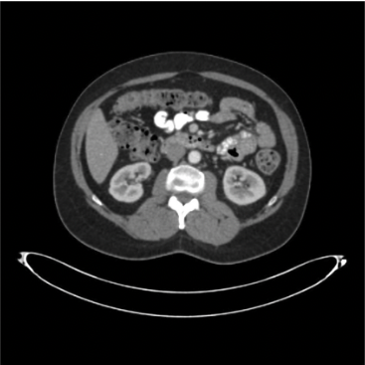
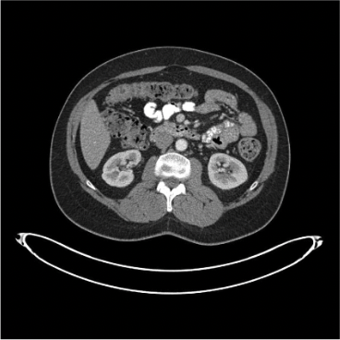
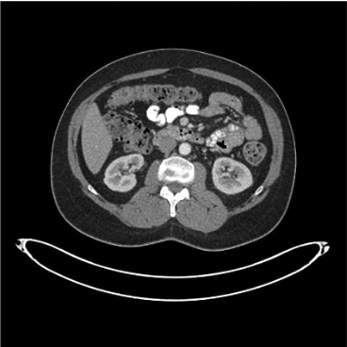
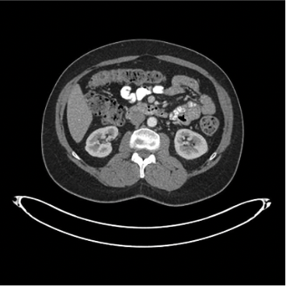
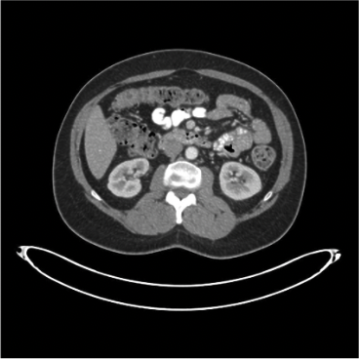
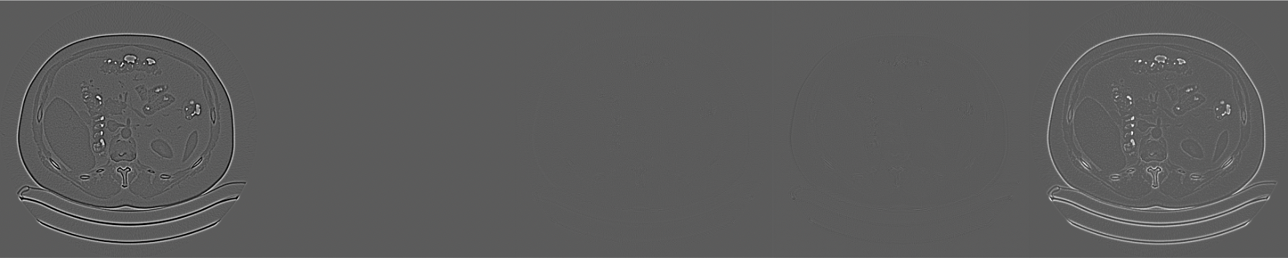
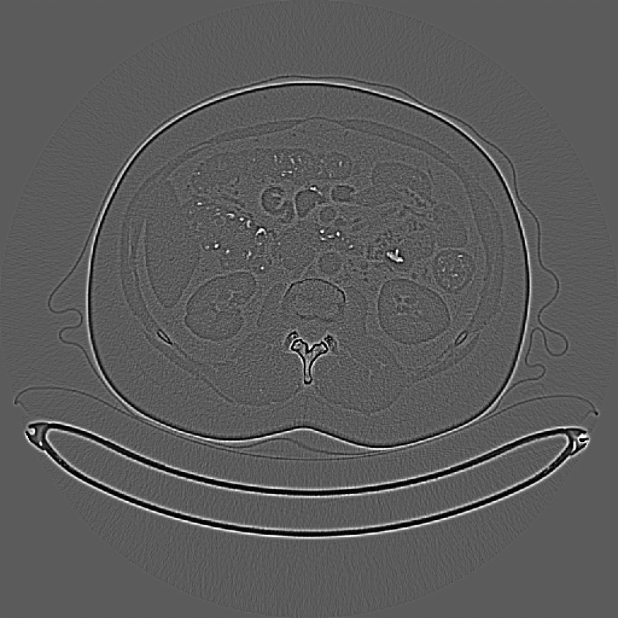

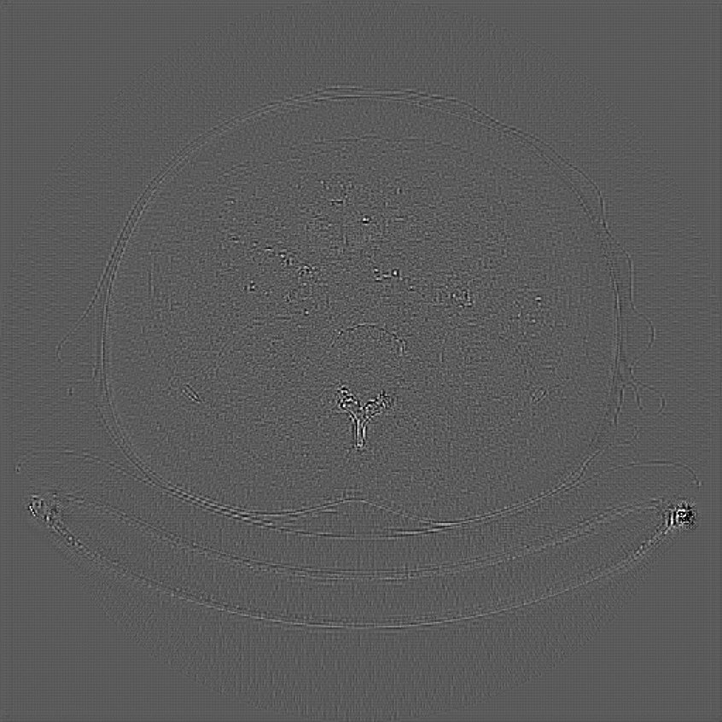
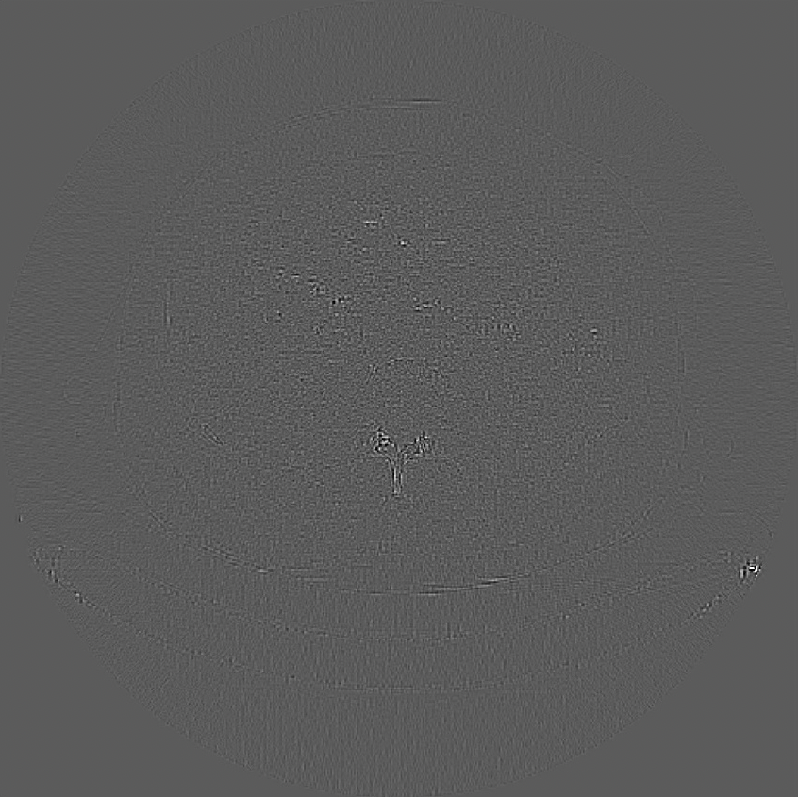
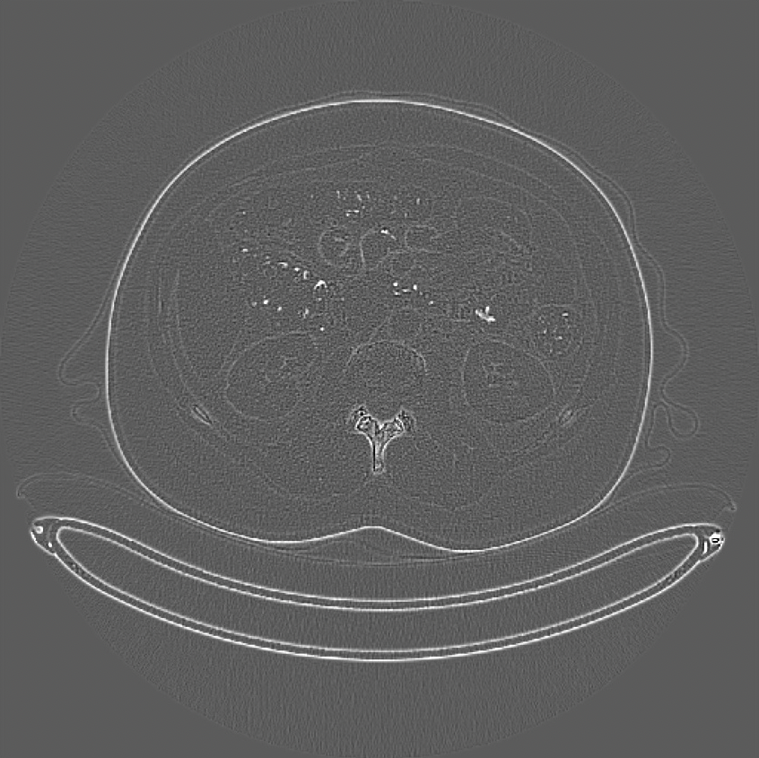
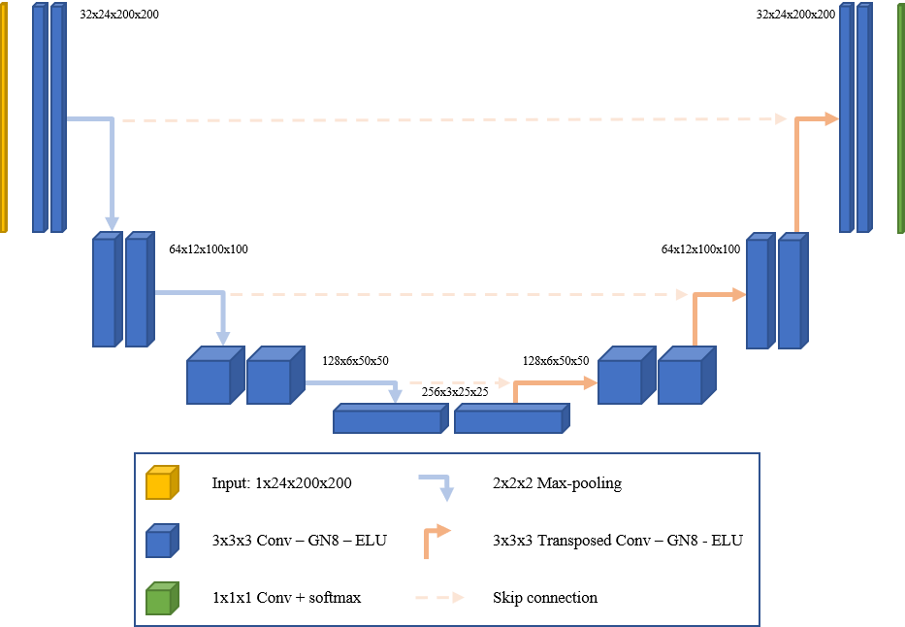
Solve Deblurring and Super Resolution in Low-dose Computed Tomography
via One Novel Neural Network
Mingjun Feng, Nixa High School
Project ID: ENBM070
♦ Introduction
♦ Model Structure
♦ Application
CT is a diagnostic imaging procedure that combines image formation using the interactions between X-rays and matter, data capture/conversion with high-end detector systems, and sophisticated algorithms to produce tomographic (cross-sectional) images. More than 70 million CT scans are performed every year in the US alone, and 300 million CT scans worldwide [Hsieh, 2003].
Currently, CT-images mostly focuses on high dose, which produces clear images; however high dose CT scans often cause great and lasting pain to patients, e.g., DNA damage, bone destruction, cancer formation.
Dense connection model is widely used in the CV tasks in recent years.
One other interesting effect that I have discovered is that mere sharpening, a simple operation that just makes a particular feature more evident in an image, provides an effect similar to that of deblurring.
I was able to develop a demo website, the CThub. The website allows the user to input a blur version of the CT image(such as nifti, rather than DICOM so the patient privacy will be persevered) and expect it to output a clear version.
Fig 1
Fig 10: A standard Dense Connection model
Fig 21: The Front End of CTHub Website
Fig 12: Model of RDN, consisting of multiple RDBs
Here is a flowchart of my website: I would ran all of the necessary programs on Google Cloud.
Fig 22: The Back End of CTHub Website
Fig 11: PSNR/SSIM comparison on dense connection models (Dataset: Set5, Set14, and Urban100)
Furthermore, the source code is published on Github. This allows others to plug and play with the code and explore the algorithm easily.
Fig 2
Residual Dense Network (RDN) is designed specifically for image super resolution and has reached state of the art (SOTA). I will first apply RDN and revised RDN to simultaneously solve blurred and low resolution problems in CT images.
Fig 13: Sharp RDN, consisting of a Sharpen layer and RDBs
The advantage of low-dose CT
Since sharpen helps with deblurring, I tried to add a sharpen layer [M. Nagare et al] to the model to see if it can perform both image super resolution and deblurring effectively.
01
Low-dose CT scans use less radiation, thus lower energy, and lower hazard compared to regular high-dose CT scans.
♦ Data & Experiment Setup
Furthermore, this work is published in:
Moreover, this type of scan is noninvasive and ionizing radiation does not remain in the body after the low-dose scans.
Fig 23: The Source Code in Github
02
The simulated dataset in this study was obtained from the American Association of Physicist in Medicine (AAPM) DL-spectral CT challenge [Sidky and Pan, 2022]. The 512×512 pixel training images are from a breast phantom simulation, a total of 1000 cases. Of 80 subjects, 63 patient scans for training, 6 for validation, and 11 for testing.
Environment setting
Programming tools: Python / Tensorflow
Computational Resource: Nvidia K80 / T4, Storage 57G, Google Colab Pro+
The 5th International Conference on Machine Learning and Natural Language Processing (MLNLP 2022) and published by ACM (ISBN: 978-1-4503-9906-7) and submitted for indexing by EI Compendex and Scopus.
03
Lung cancer screening with low-dose CT also does not require contrasting material.
Because the U-net structure’s output size is the same as the input size, the training input is first down resolution then up resolution.
♦ Conclusion and future work
Fig 14
The clinical dataset was obtained from the The Cancer Imaging Archive (TCIA) Pancreas-CT data [Roth et al., 2016]. The dataset includes 80 abdominal contrast-enhanced 3D CT scans from 53 male and 27 female subjects. The image size is 512 × 512. Total of 1230 images divided into three groups with 968 for training, 103 for validation, and 159 for testing.
Three deep learning models – RDN, Sharp RDN, and Sharp U-net was trained with two medical CT datasets.
Performances of the three models were compared qualitatively and quantitatively. The regular RDN performed the best on image deblurring.
When doing SR, based solely on PSNR and RMSE, the RDN did better than the other two, yet when based on SSIM, the result showed that the Sharp U-Net did the best.
A website named CTHub was developed to help doctors to improve the quality of CT images.
However, low-dose CT significantly degrades the CT image quality, and causes problems such as blurring, noise, and compromised spatial resolution.
Achievements:
Fig 3: Normal Image
Fig 4: Blurred Image
Fig 15
Fig 16
♦ Results
To measure my result, I used peak signal to noise ratio, structural similarity index measure, and the root mean square error.
The Peak Signal to Noise Ratio measures the amount of noise in that image
Structural Similarity Index Measure the similarity of the images
Root Mean Square Error measure the difference between the target and predicted image by looking at the pixel to pixel difference.
Future work:
Fig 5: Low Resolution
Image
An experiment to determine the optimal number of RDBs for each of the tasks for CT medical images.
An experiment of SR by combining Sharp U-net and RDN—that is, let the Sharp U-Net first up resolution then train the RDN to match the corresponding images.
An online doctor interrogation model with ChatGPT.
Fig 6: Noise Image
Below is the both visual and numerical difference between the ground truth (the high possible quality achievable) and the predicted images.
♦ References
♦ Related Work:
AAPM
Deblur
Result
Blurred Ground Truth RDN Sharp RDN Sharp U-Net
AAPM
SR
Result
Downsampled Groundtruth RDN Sharp RDN Sharp U-Net
[Hsieh, 2003] Hsieh, J. (2003). Computed tomography: principles, design, artifacts, and recent advances.
[Sidky and Pan, 2022] Sidky, E. Y. and Pan, X. (2022). Report on the aapm deep-learning sparse-view ct grand challenge. Medical Physics.
[Roth et al., 2016] Roth, H. R., Farag, A., Turkbey, E. B., Lu, L., Liu, J., and Summers, R. M. (2016). Data from pancreas-ct. The cancer imaging archive, 32.
Zhang, Y., Tian, Y., Kong, Y., Zhong, B., and Fu, Y. (2020).
Residual dense network for image restoration. IEEE Transactions on Pattern Analysis and Machine Intelligence, 43(7):2480–2495.
Al‐Ameen, Zohair, and Ghazali Sulong. "A novel Zohair filter for deblurring computed tomography medical images." International Journal of Imaging Systems and Technology 25.3 (2015): 265-275.
Meijering, Erik HW, Wiro J. Niessen, and Max A. Viergever. "Quantitative evaluation of convolution-based methods for medical image interpolation." Medical image analysis 5.2 (2001): 111-126.
M. Nagare et al., "A Noise Preserving Sharpening Filter for CT Image Enhancement," 2022 IEEE International Conference on Image Processing (ICIP), Bordeaux, France, 2022, pp. 2566-2570, doi: 10.1109/ICIP46576.2022.9897227.
You, Chenyu, et al. "CT super-resolution GAN constrained by the identical, residual, and cycle learning ensemble (GAN-CIRCLE)." IEEE transactions on medical imaging 39.1 (2019): 188-203.
Fig 1, 2, 15: TCIA dataset
Fig 14: AAPM dataset
Fig 3, 4, 5, 6, 13, 16, 17, 18, 19, 20, 21, 22, 23: Student created
Fig 7: https://www.geog.leeds.ac.uk/groups/geocomp/1999/082/gc_082.htm
Fig 8: Regression Analysis using Deep Learning
Fig 9: https://towardsdatascience.com/creating-and-training-a-u-net-model-with-pytorch-for-2d-3d-semantic-segmentation-model-building-6ab09d6a0862.
Fig 10 and 11: Li, Juncheng, Zehua Pei, and Tieyong Zeng. "From beginner to master: A survey for deep learning-based single-image super-resolution." arXiv preprint arXiv:2109.14335 (2021).
Fig 12: Zhang, Y., Tian, Y., Kong, Y., Zhong, B., and Fu, Y. (2020).
Residual dense network for image restoration. IEEE Transactions on Pattern Analysis and Machine Intelligence, 43(7):2480–2495.
Conventional Methods
Deblurring: Each CT-machine has its own defect, yet the filter will do the same operation no matter what the defect is. So the result might be not well.
Super Resolution: Interpolation would be used. However, because interpolation just takes the average of surrounding pixels, important information is often lost.
Deep Learning Methods
Deep learning methods consist of convolutional kernels, and each kernel learns certain features of an image. However, most of the network is designed to solve a problem and therefore often fails on other tasks [You, 2019, CT].
U-net
U-net is one of the established networks in the area of medical imaging segmentation. The structure looks like a “U” since the information is pressed and folded back again.
Fig 17
Blurred Ground Truth RDN Sharp RDN Sharp U-Net
-Ground Truth -Ground Truth -Ground Truth -Ground Truth -Ground Truth
Fig 18
Downsampled Ground Truth RDN Sharp RDN Sharp U-Net
-Ground Truth -Ground Truth -Ground Truth -Ground Truth -Ground Truth
Fig 7
 | Blurred | RDN | Sharp RDN | Sharp U-Net
PSNR | 27.34 | 48.86 | 48.45 | 30.12
SSIM | 0.61 | 0.99 | 0.99 | 0.73
RMSE | 0.0431 | 0.0036 | 0.0038 | 0.0312
 | Downsampled | RDN | Sharp RDN | Sharp U-Net
PSNR | 23.65 | 26.49 | 26.35 | 22.84
SSIM | 0.79 | 0.8 | 0.81 | 0.76
RMSE | 0.0609 | 0.0382 | 0.0385 | 0.042
TCIA
Deblur
Result
Blurred Ground Truth RDN Sharp RDN Sharp U-Net
TCIA SR
Result
Downsampled Ground Truth RDN Sharp RDN Sharp U-Net
Fig 8
Fig 19
Blurred Ground Truth RDN Sharp RDN Sharp U-Net
-Ground Truth -Ground Truth -Ground Truth -Ground Truth -Ground Truth
Fig 20
Downsampled Ground Truth RDN Sharp RDN Sharp U-Net
-Ground Truth -Ground Truth -Ground Truth -Ground Truth -Ground Truth
 | Blurred | RDN | Sharp RDN | Sharp U-net
PSNR | 13.14 | 37.24 | 36.1 | 21.56
SSIM | 0.92 | 0.99 | 0.99 | 0.96
RMSE | 50.48 | 10.85 | 11.78 | 33.11
 | Downsampled | RDN | Sharp RDN | Sharp U-Net
PSNR | 37.219 | 48.667 | 42.791 | 40.329
SSIM | 0.44 | 0.538 | 0.407 | 0.586
RMSE | 42.927 | 11.837 | 23.7 | 30.126
Fig 9
Motivation: I want to perform both deblurring and super resolution on low-dose CT images by using one AI neural network. My technology can provide high quality medical images for doctors and reduces the risk for patients.
As one can see here, each of the visual comparison contains two row. The first row is the predicted images and the bottom row is the subtractions of between the prediction and the ground truth. So the more smooth it is, the closer the predicted image is to the ground truth. Base on the visual comparison and the numerical comparison, it can be seen that RDN and Sharp RDN did significantly better than the Sharp U-net.

